Slide 1
Objects Dao - Full on-chain community starter system built on Obelisk Generator
Topic Randomness
Objects Dao is an innovative pilot project that aims to better guide the community's use of identity, governance, and funding based on the Aptos network through the introduction of the Obelisk Generator's fully on-chain dynamic metadata-generating technology, as well as to facilitate the development of an ecosystem of fully on-chain technologies and their associated protocols.

Slide 2
Dynamic (meta)data generation techniques (early history)
Traditional Dynamic NFT (Dynamic NFT) supports on-chain updates, but the computational process and media resources are still off-chain. It is not possible to achieve complete data authorization, storage and scalability.

Slide 3

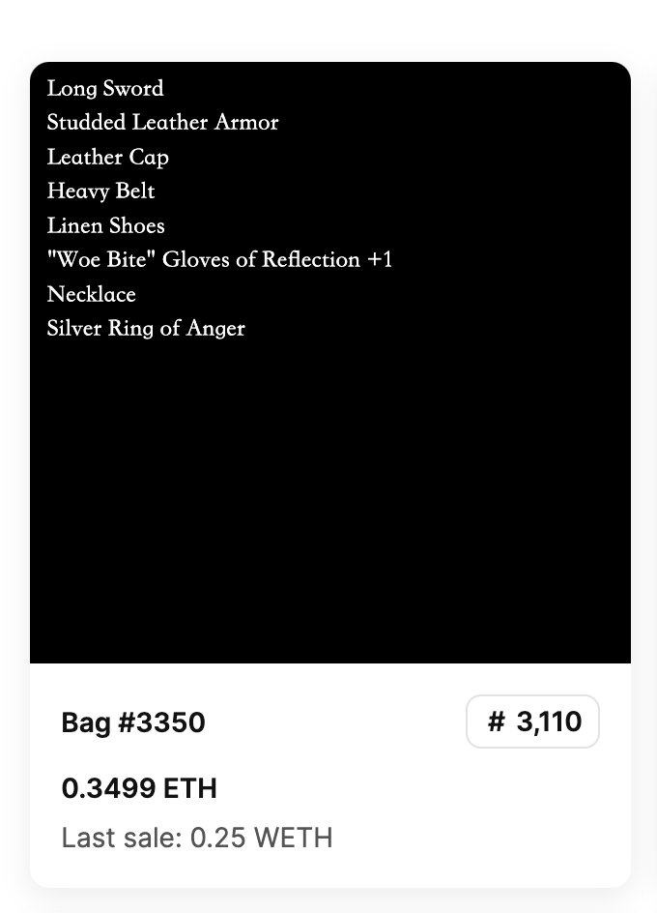
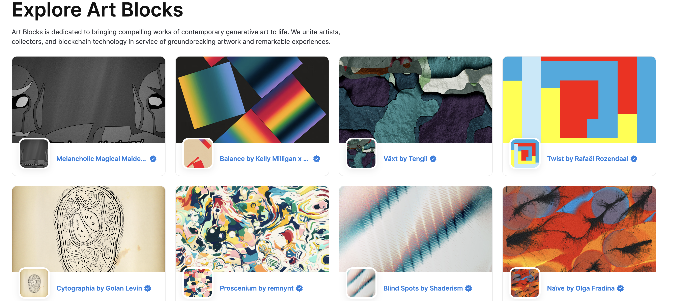
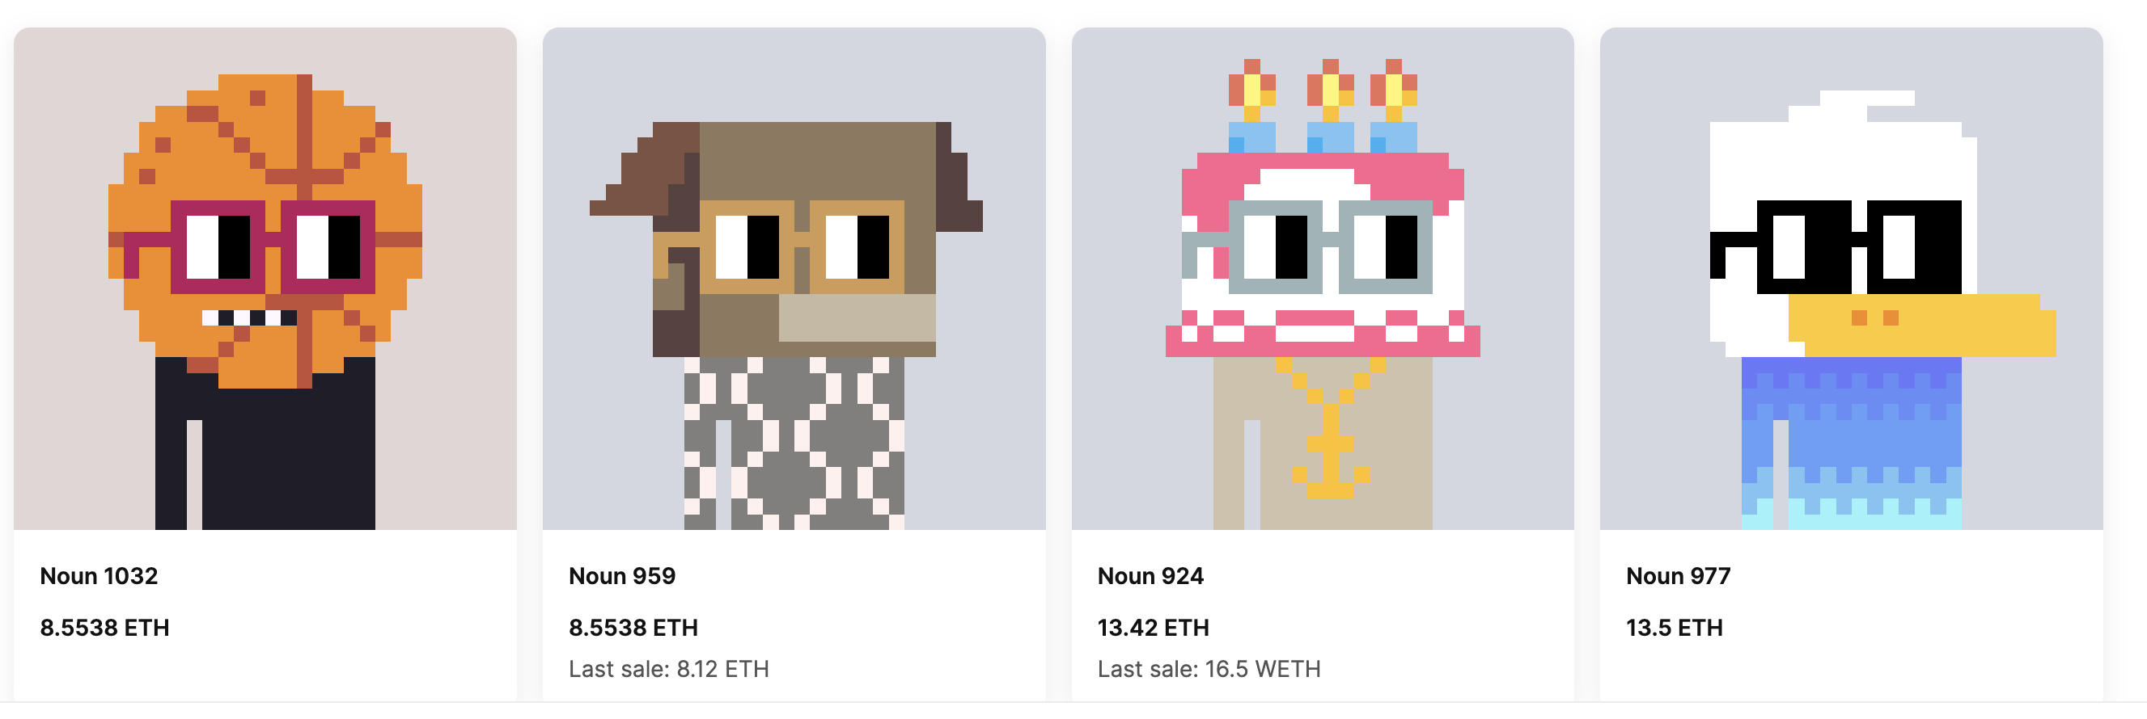
Evolvable Communities (Ethereum) Current Status

Slide 4
Challenges of existing fully on-chain communities
High GAS fees and inefficient serial transaction processing capabilities
Potential security risk of cross-contract internal calls leading to compromise of public funds
Lack of trustworthy on-chain random number generation (metadata information for dynamically generated assets/game props).
Lack of a common protocol specification to efficiently extend and customize your community
Results: High cost of participation, risk of community contract funding, and limitations on community design and functionality expansion

Slide 5
Objects Dao (solution)
Optimize the code by choosing Move language and use Aptos to reduce operation cost and improve network throughput "to solve the high cost of user participation and the risk of community contract funds".
Generate Objects Assets Metadata based on Aptos built-in randomness API.
Dynamic generation of Move metadata information through Obelisk Generator.
Constructing a common on-chain standard and the toolchain required for its use "to solve the limitations of community design and functionality expansion".

Slide 6
Obelisk Generator
Obelisk Generator is a fully on-chain, dynamically generated (meta)data technology written in the Move language, designed and developed by Obelisk Labs in conjunction with Objects Dao.

Slide 7
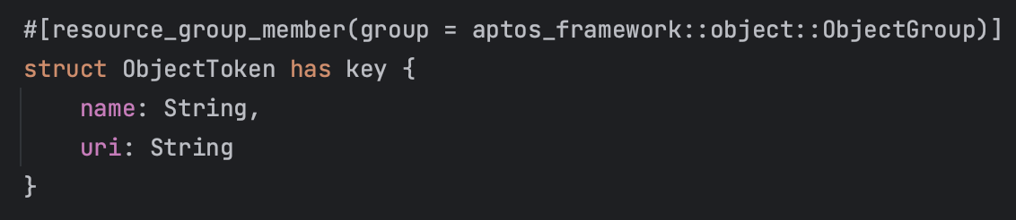
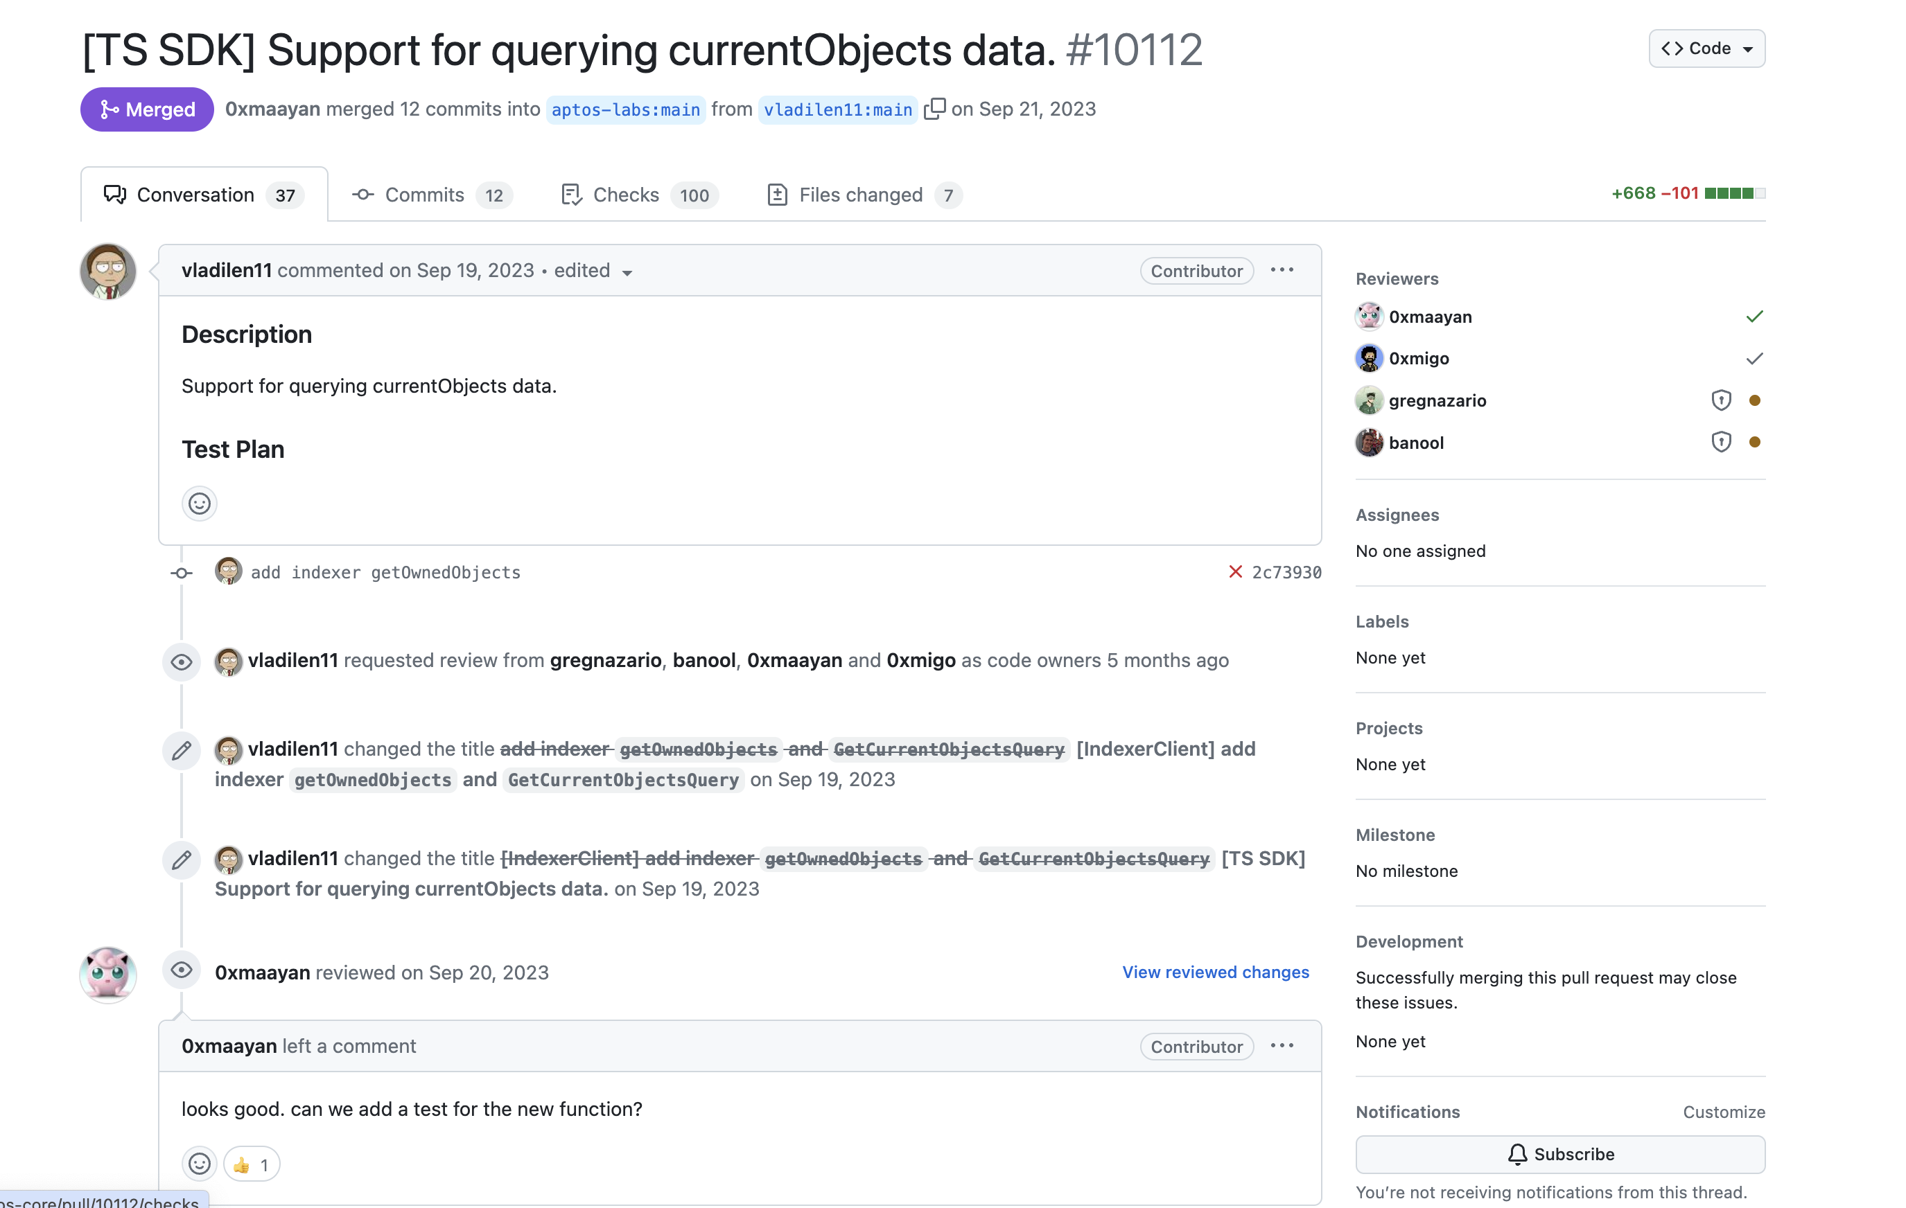
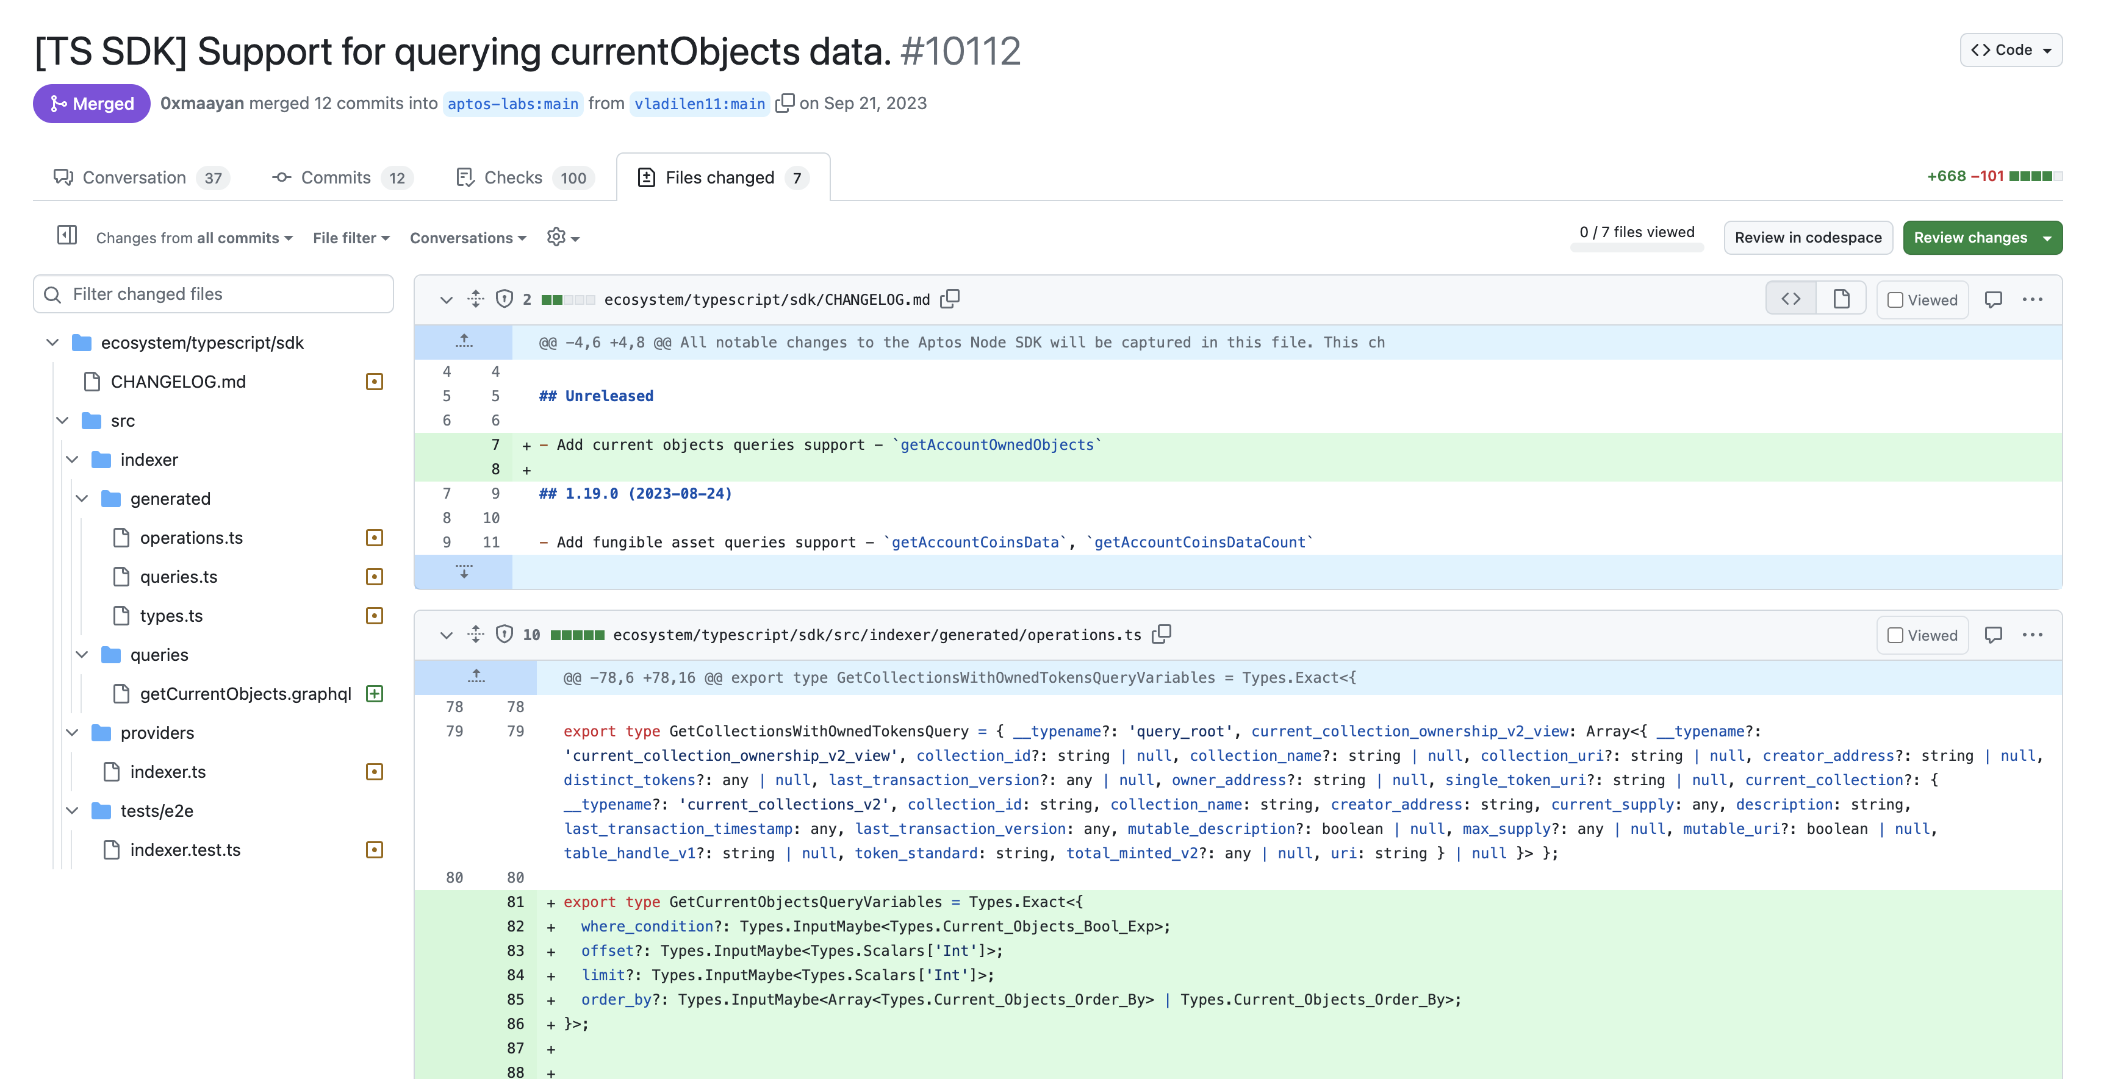
Obelisk Generator Aptos Object Support

Slide 8
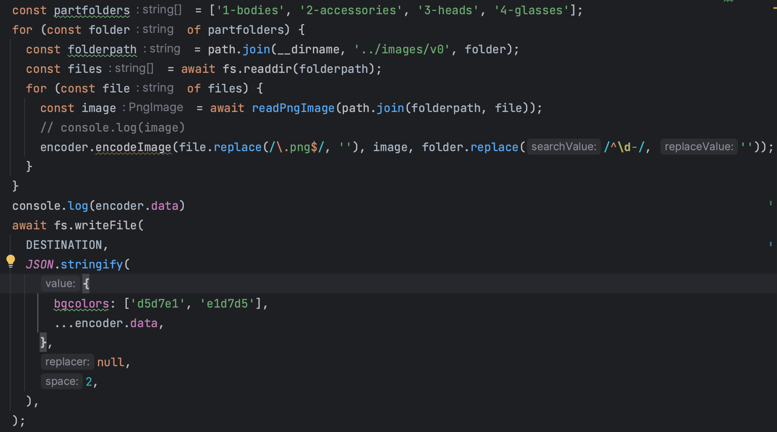
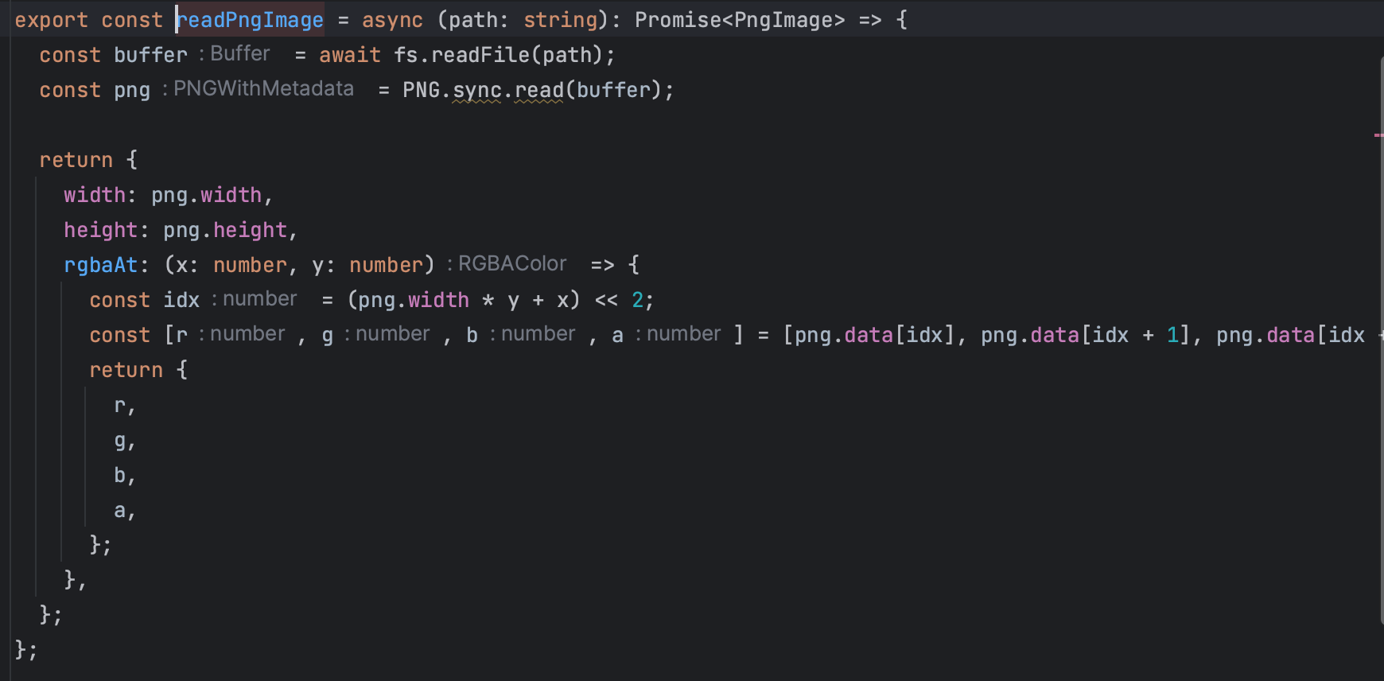
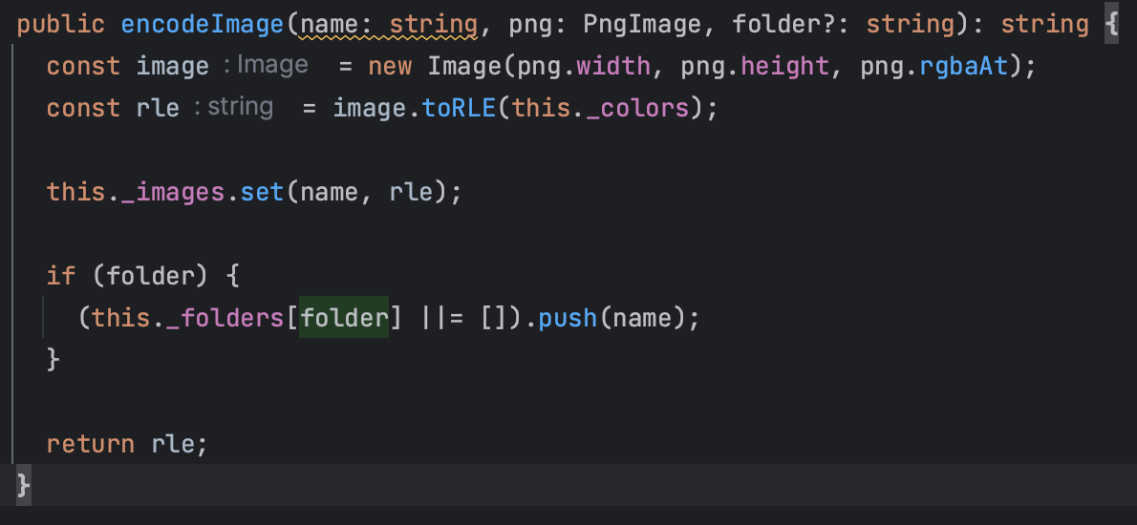
Obelisk Generator toolchain Process

Slide 9
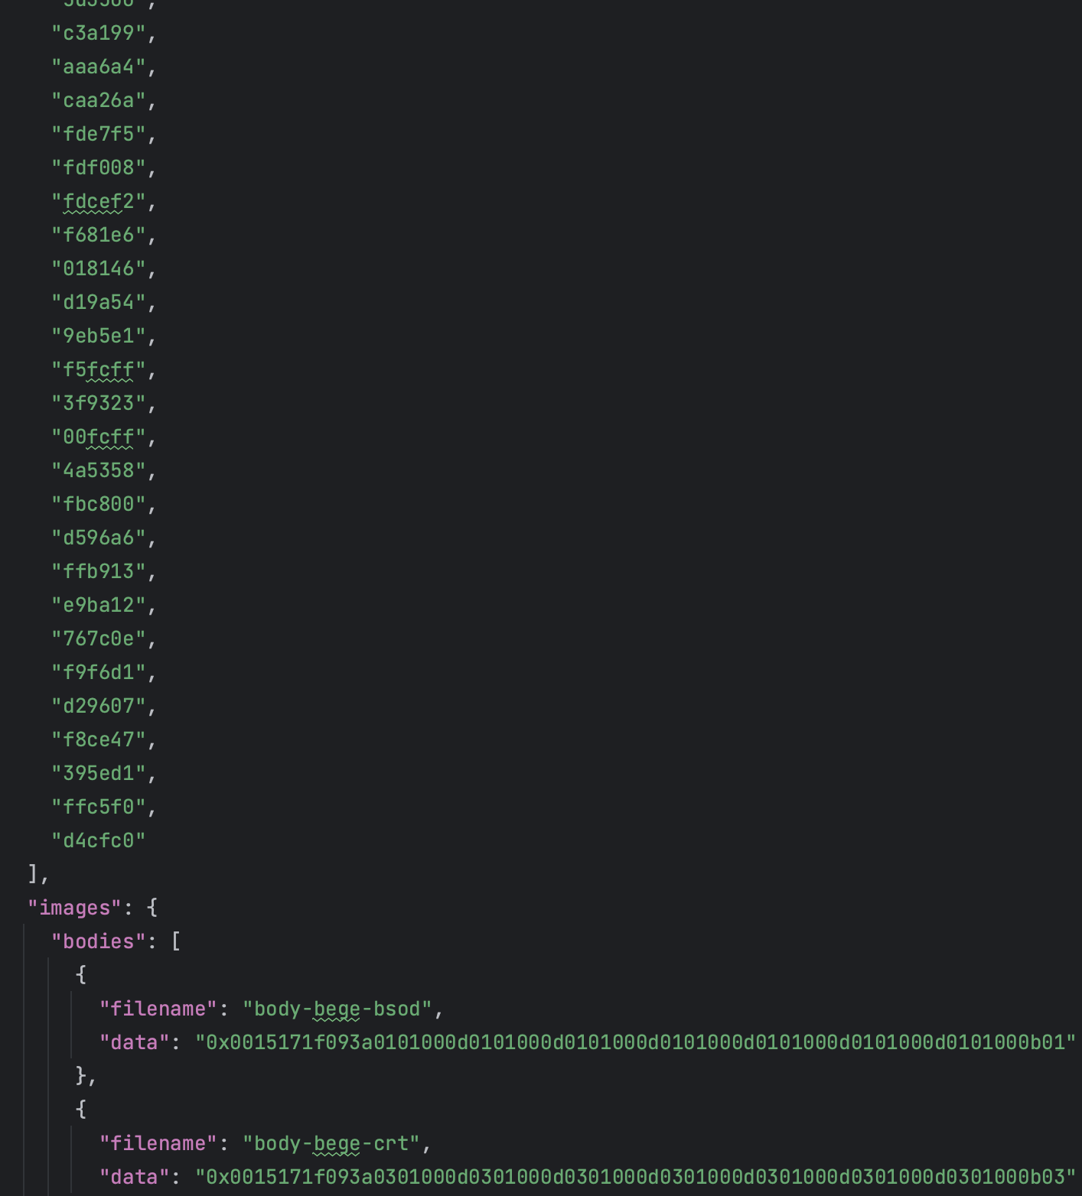
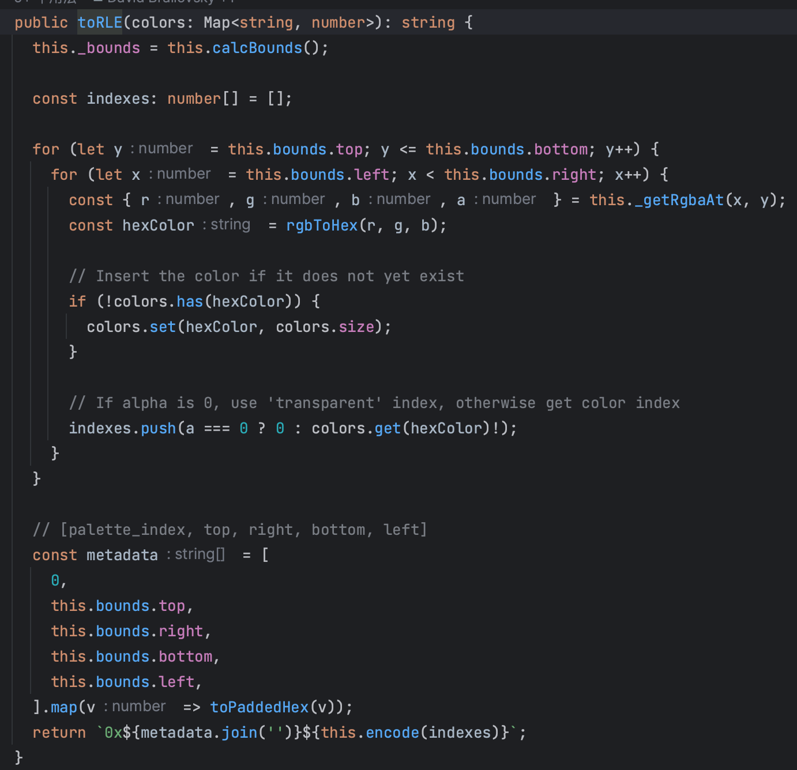
Obelisk Generator toolchain Process

Slide 10
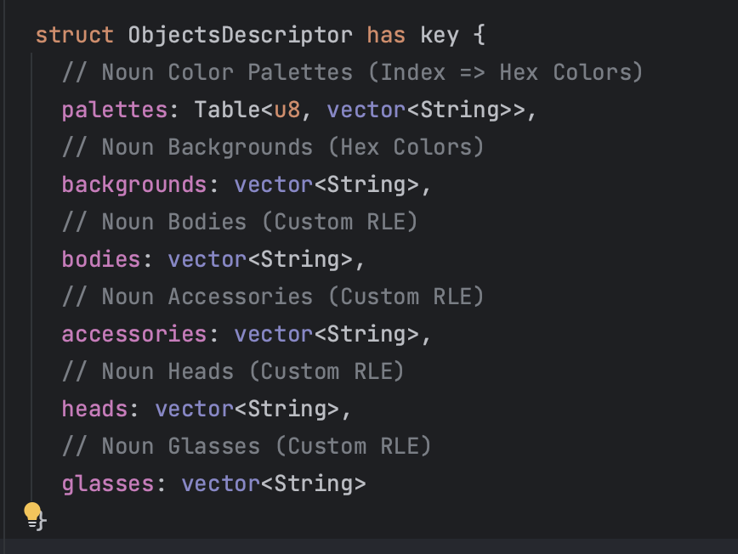
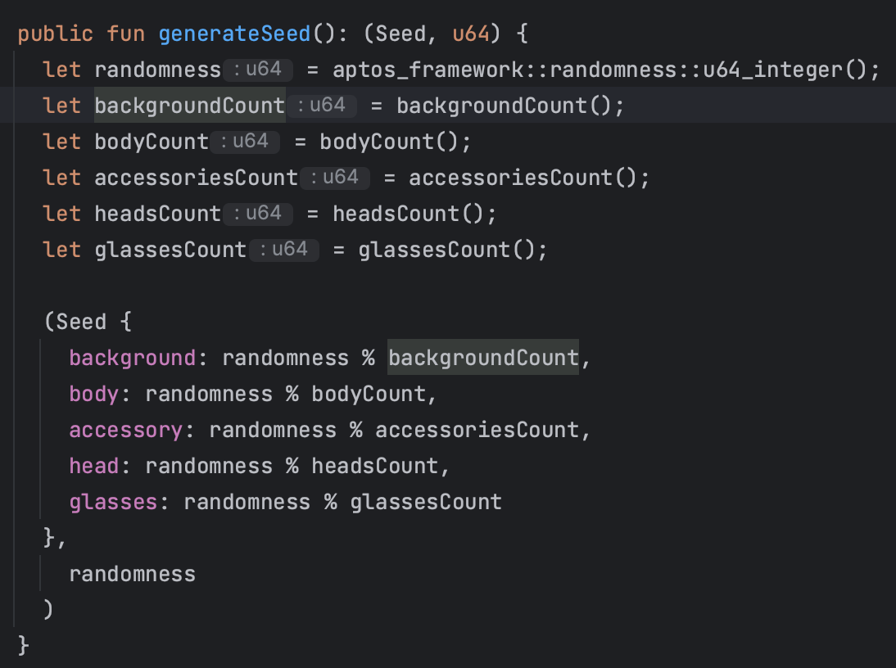
Obelisk Generator On-Chain Process

Slide 11
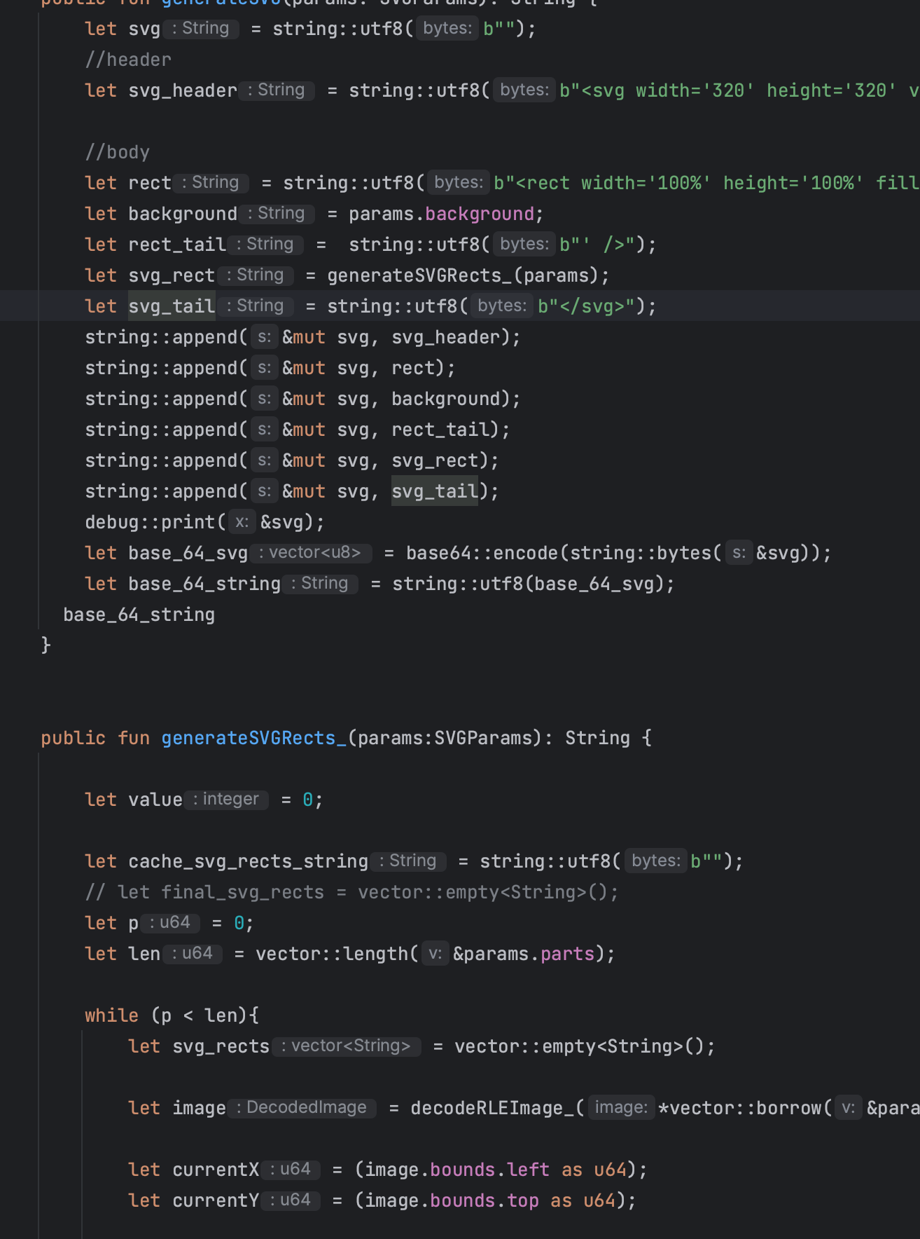
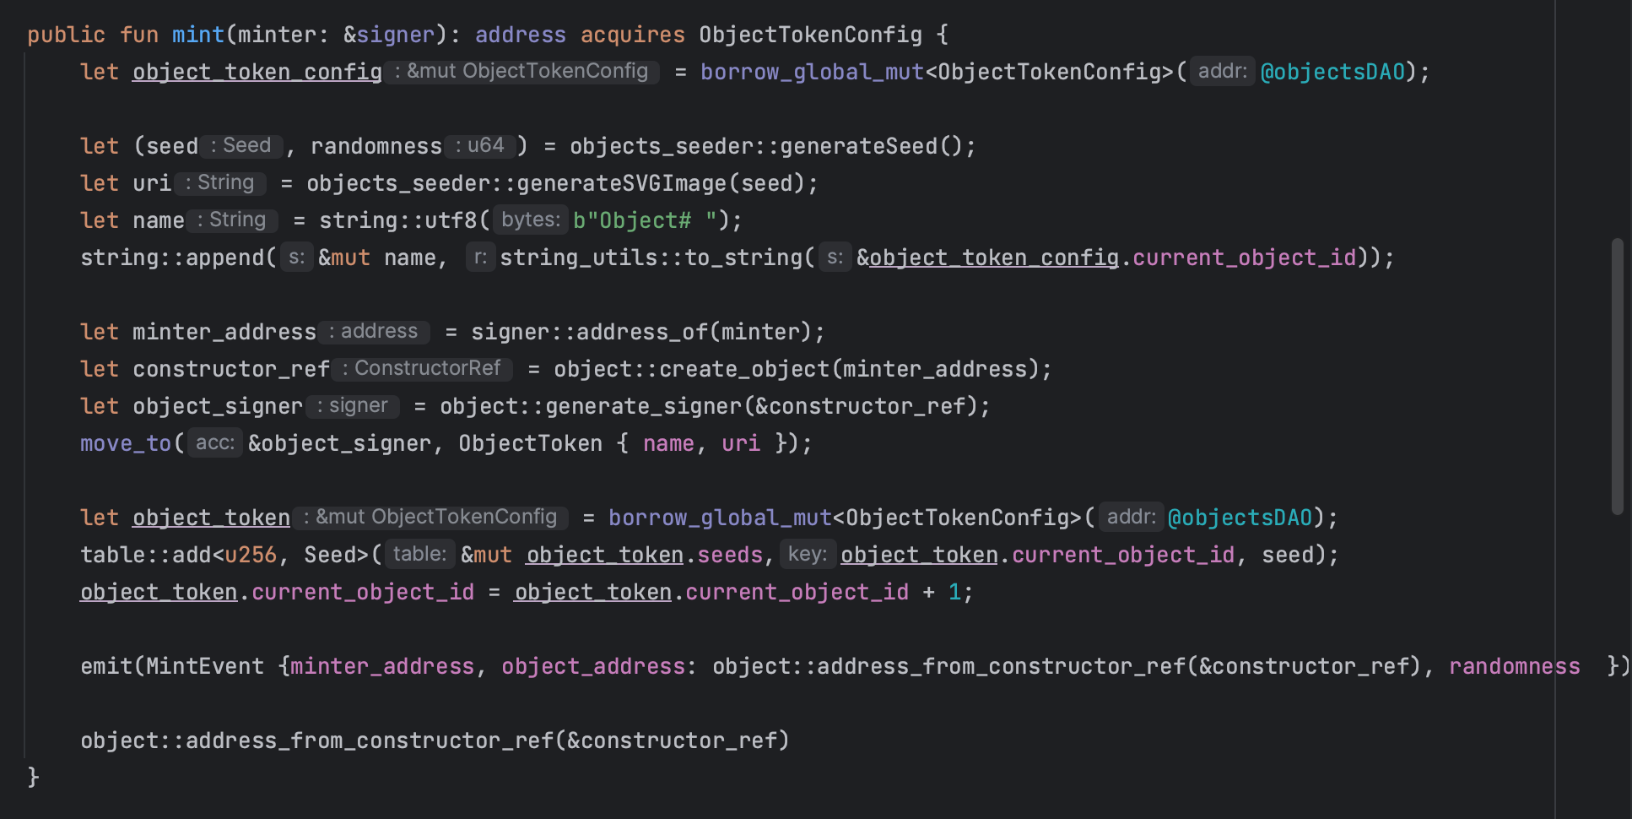

Obelisk Generator On-Chain Libs

Slide 12
Obelisk Generator Core
The toolchain encodes the Media Type and stores it in the chain at a granularity that reduces the one-time processing overhead.
Lossless compression according to the compression algorithm (RLE<Run-length encoding>/more...).
Json Metadata input to the chain (seed contract).
Contract splices the data according to the random numbers on the chain and the business logic of the contract (processing contract)
Then output by parsing the contract

Slide 13
Obelisk Generator Features and Future
The more Modules deployed on the Move platform, the greater the interoperability between the projects, and the more the projects can re-combine and re-calculate the generated data through their respective seed data modules and processing modules to re-generate the asset/non-asset metadata information, which acts as the user-visible on-chain representation/rendering layer and deeply integrates with the user interaction of the projects.
Generator deployed on Move platform can provide more metadata related on-chain module support such as media types, which can be combined and loaded to generate different types of metadata related media formats or information support.
The randomness API supported by Move platform introduces randomness support in the on-chain module to bring complexity factors to the dynamic metadata generation technology to improve the friction so as to reasonably and fairly carry out business operations on asset/non-asset data.

Slide 14
Solutions for Objects Dao (Economic Model)
Based on Objects Token auction to get identity and governance rights, shorten the time interval between auctions.
Introducing the concept of "weighted voting" to expand the participation of ordinary users in governance, and obtaining funds through proposals and community voting results.
Build a community for yourself and some other groups through toolchain and Objects Dao in the form of soft "forking" and get part of the forked funds from Objects Dao.
And more..

Slide 15
Obelisk Generator and Objects Dao Usage Groups and Scenarios
Project owners (decentralized finance, gaming, social, art collectibles, etc.)
Developers/Users (community launches, crowdfunding projects, trading platforms)
(Use Obelisk Generator to generate metadata information for on-chain asset/game/social data, and use Objects Dao to tightly integrate project and identity, development governance, and community funding to promote project and community self-evolution).

Slide 16
Objects Dao POC -> MVP

Slide 17
Objects Dao Public Roadmap
2024 Q2
Objector Convening
Objects Dao Testnet → Mainnet
Community Building
2024 Q4
Upgrading community governance
Developing community projects
Organizing community competitions
2024 Q3
Community Protocolization Realization
Launching Branding Collaboration
Organize community events

Slide 18
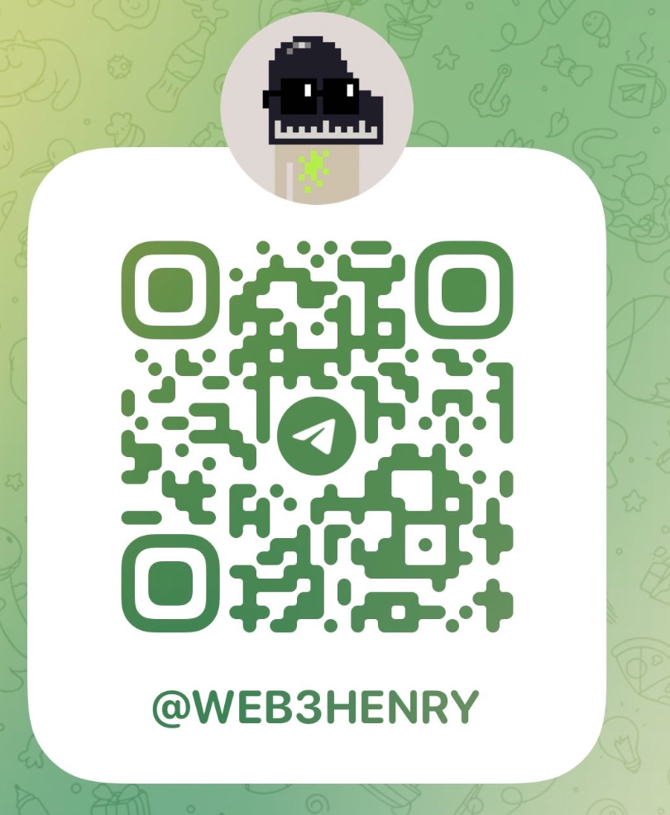
About US
Twitter twitter.com/objects_dao
Website objects.club

